Slide 1


Department of Computer Science and Engineering
Smart Career Pathway Advisor Using GenAI
NAVEEN KUMAR K (210701174)
JAYA SURIYA R(210701513)
Supervisor
Mrs. ADLIN LAYOLA J A
Assistant Professor(SG)

Slide 2
Introduction
The Smart Career Pathway Advisor is an AI-powered, web-based platform designed to help individuals discover and plan personalized career pathways. In today’s rapidly changing job market, it is increasingly difficult for people to stay informed about emerging roles, required skills, and career opportunities. Whether a student deciding on future studies or a professional looking to upskill, individuals need tailored guidance to navigate their career growth effectively.
By integrating Big Data analytics and Generative AI, the platform provides users with dynamic career recommendations based on their current skills, interests, and goals. It analyzes real-time labor market trends, identifies skill gaps, and generates personalized career roadmaps, including learning resources, certifications, and job suggestions.
The platform continuously adapts to market shifts, ensuring users receive the most up-to date guidence.

Slide 3
Literature Review
For literature review or survey refer this link.
https://docs.google.com/document/d/1FNLEtEuh6PWLBJIUTauskOBgt3P3ZgR2Hz9E0CaJTf0/edit?usp=sharing

Slide 4
Summary of Literature Review
The reviewed papers collectively emphasize the growing integration of AI and machine learning in career guidance and educational systems, focusing on personalized, dynamic, and data-driven approaches. Models like ALS, Naïve Bayes, XGBoost, and Generative AI are used to offer tailored career recommendations, re-education paths, and skill gap analysis. A recurring theme is the shift from static, rule-based systems to real-time, adaptable solutions that leverage Big Data for continuous updates, particularly in rapidly evolving job markets. Papers like PCRS and Personalized Career-Path for IT Students highlight the importance of localized and domain-specific models, while others, such as AI-Powered University Guidance and Resume-Based Re-Education, stress the need for holistic solutions across diverse fields.
Additionally, issues of gender disparity and re-entry challenges are addressed, underscoring the importance of supportive and flexible re-skilling programs. Across the board, the literature identifies the need for enhanced scalability, multidisciplinary collaboration, and the application of AI to bridge skill gaps and align career pathways with market demands.

Slide 5
Problem Statement
Problem Statement:
Navigating today’s fast-changing job market is challenging, with individuals often struggling to align their skills and interests with evolving industry demands. Many lack personalized guidance to identify skill gaps and career opportunities, leading to missed opportunities or career stagnation.
Motivation:
The Smart Growth Pathways Advisor seeks to bridge this gap by using Big Data and Generative AI to provide personalized career guidance. As industries rapidly evolve, traditional career counseling falls short in offering real-time, tailored insights. By leveraging dynamic job market data and AI-driven recommendations, the project empowers individuals to make informed career decisions and build future-ready skills, helping users of all ages and career stages succeed.

Slide 6
Objectives
Deliver Personalized Career Guidance: Provide tailored career recommendations based on individual skills and goals using AI and data analytics.
Integrate Real-Time Market Data: Use Big Data to offer up-to-date insights into job trends and skill demands.
Identify Skill Gaps: Highlight gaps between users' skills and market needs, recommending targeted learning resources.
Generate Custom Career Pathways: Create personalized career development plans with suggested roles and actionable steps.
Recommend Learning Resources: Suggest courses and certifications aligned with users’ career goals.
Ensure Continuous Adaptation: Update recommendations based on evolving market trends and user progress.

Slide 7
Abstract
The Smart Career Pathways Advisor is an innovative web-based platform designed to help individuals navigate their career development with personalized, data-driven insights. By integrating Big Data analytics and Generative AI, the platform offers tailored career recommendations based on users' skills, interests, and goals. It analyzes real-time job market trends and identifies skill gaps, providing users with customized career pathways and actionable steps to achieve their aspirations. The system also suggests relevant learning resources and continuously updates recommendations to reflect the latest market changes. The interactive dashboard enhances user engagement by visually tracking progress and forecasting future career outcomes. This approach aims to empower individuals at all career stages with the knowledge and tools needed to make informed decisions and succeed in a rapidly evolving job market.

Slide 8
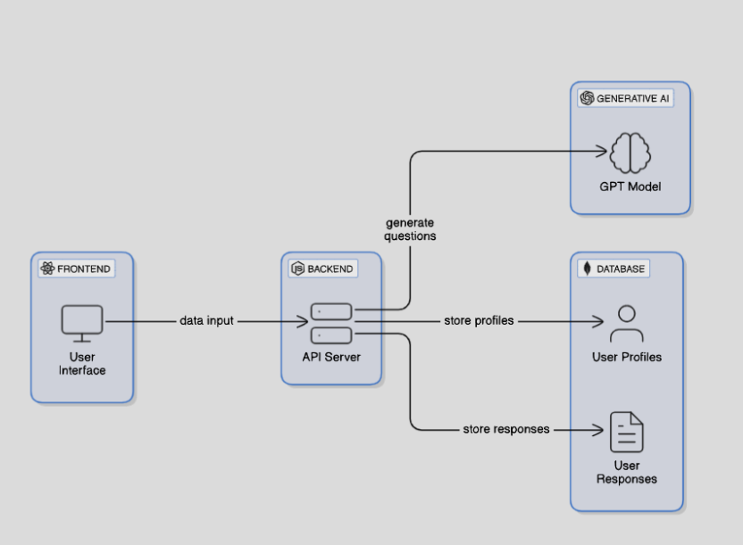
System Architecture

Slide 9
List of Modules
User Input Collection
Dynamic question generation
User Response Collection and Storage
Skill and Gap Analysis

Slide 10
Functional Description for each modules
User Input Collection Module
Collects demographic details, technical skills, career goals, and education levels.
Ensures real-time validation for accurate data entry.
Dynamic Question Generation Module
Generates personalized multiple-choice questions (MCQs) using Generative AI models like GPT.
Tailors questions to the user’s profile to refine their data.
User Response Collection and Storage Module
Captures user responses to dynamic questions.
Stores data securely in a NoSQL database (e.g., MongoDB) for analysis.
Skill and Gap Analysis Module
Analyzes user responses and profiles using Big Data frameworks like Apache Spark.
Identifies skill gaps and compares them with real-time job market demands.

Slide 11
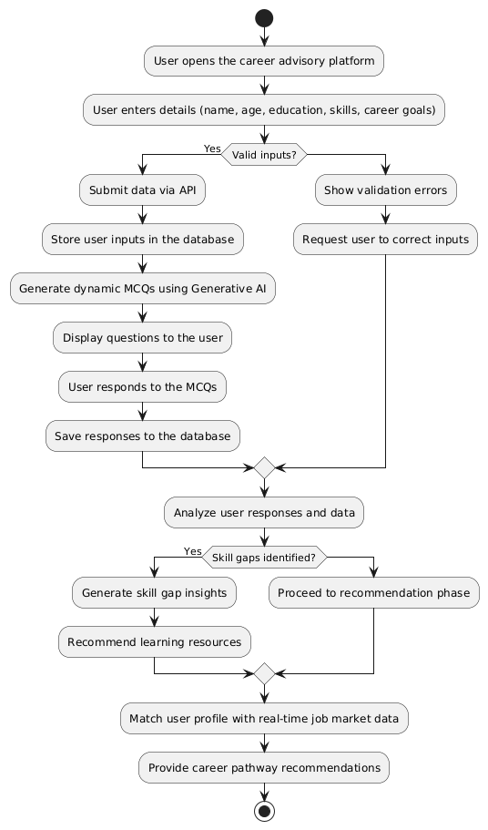
Activity Diagram

Slide 12
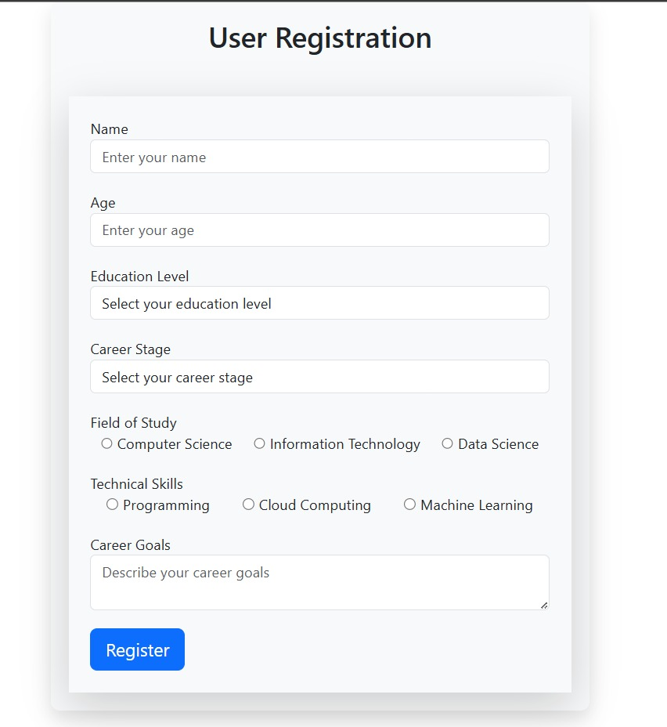
Implementation & Results of First Module

Slide 13
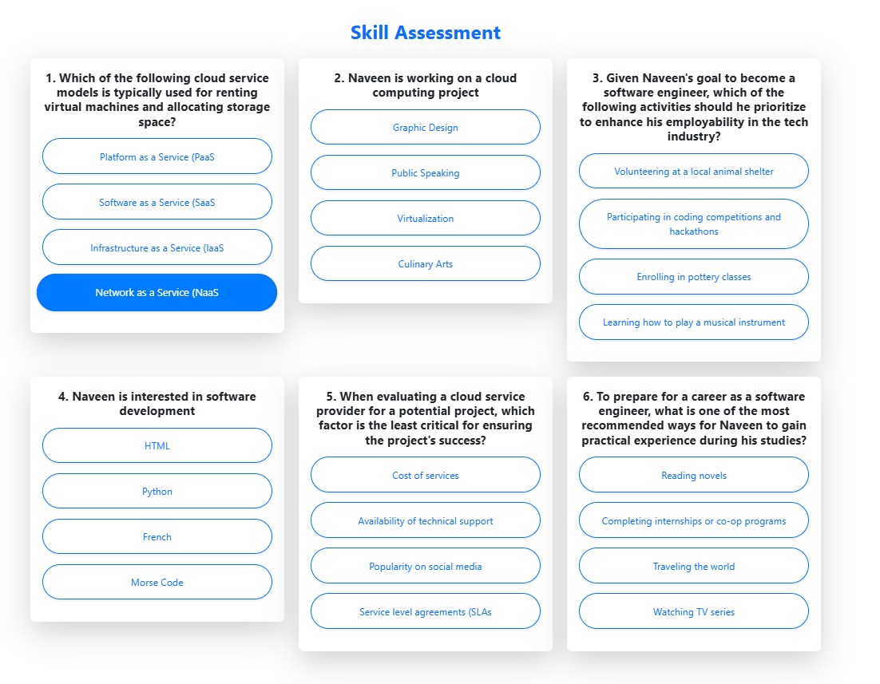

Slide 14
Conclusion & Work for Phase II
Phase 2 of the Smart Career Pathway Advisor focuses on generating personalized career pathway recommendations by analyzing user profiles, skill gaps, and real-time job market data. Using advanced models like ALS for collaborative filtering and NLP for pathway formatting, this phase bridges the gap between user aspirations and industry demands.
Future Work includes enhancing scalability with real-time updates via Kafka streams, integrating more dynamic job market APIs, and incorporating AI-driven predictive analytics to foresee future skill demands. This will ensure a continually evolving and highly personalized advisory system, empowering users to make data-driven career decisions in the IT domain.

Slide 15
References
To view the reference papers taken, refer this link.
https://docs.google.com/document/d/1ZRfNtDGzD4qRSTkkzn-nBbCVR1mqBN51pZXEDSuyOxU/edit?tab=t.0

Slide 16
Paper Publication Status
PUBLICATION STATUS: Submitted to the conference and waiting for the Acceptance.
TITLE OF THE PAPER: Smart Career Pathway Advisor Using GenAI
AUTHORS: Adlin Layola J A, Naveen Kumar K, Jaya Suriya R
NAME OF THE CONFERENCE: INTERNATIONAL CONFERENCE ON EMERGING RESEARCH IN COMPUTATIONAL SCIENCE – 2024

Slide 17
Thank You

